Slide 1
Terraform
Terraform is an open-source infrastructure-as-code software tool created by HashiCorp.
IaC allows you to build, change, and manage your infrastructure in a safe, consistent, and repeatable way by defining resource configurations that you can version, reuse, and share.
Multi-Cloud and Multi-Provider Support: Terraform supports multiple cloud providers, such as AWS, Azure, Google Cloud, and more. It also supports other services and systems, including Kubernetes, GitHub, and databases. This allows you to manage resources across different providers using a single tool and configuration language.

Slide 2
PROVIDERS
A provider is a plugin that lets Terraform manage an external API.
Terraform is an infrastructure as code (IaC) tool that allows you to define and manage your infrastructure resources in a declarative manner. It supports various cloud providers (such as AWS, Azure, Google Cloud, etc.)
Every resource type is implemented by a provider; without providers, Terraform can't manage any kind of infrastructure.
terraform {
required_providers {
azurerm = {
source = "hashicorp/azurerm"
version = "3.58.0"
}
}
}
provider "azurerm" {
# Configuration options

Slide 3
RESOURCE
In Terraform, resource is a fundamental building block used to represent and manage a specific infrastructure object or entity.
resource "azurerm_resource_group" "RG" {
name = "3tierArchRG"
location = "EAST US"
}

Slide 4
We are creating a Linux virtual machines using terraform in Azure
Below are the prerequisites to achieve:-
Resource Group
Virtual Network
Subnet
NIC
Azure Public IP
Virtual Machine
NSG Group
NSG Group Association

Slide 5
Resource Group:-
logical container that helps you manage and organize related Azure resources. It acts as a fundamental unit for grouping resources that belong to a single application, project, or service.
azurerm_resource_group
Terraform documentation For Azure resource group creation
https://registry.terraform.io/providers/hashicorp/azurerm/3.58.0/docs/resources/resource_group
resource "azurerm_resource_group" "example" {
name = "example"
location = "West Europe"
}

Slide 6
Virtual Network:- Manages a virtual network including any configured subnets. Each subnet can optionally be configured with a security group to be associated with the subnet.
Terraform documentation For Azure resource group creation
https://registry.terraform.io/providers/hashicorp/azurerm/latest/docs/resources/virtual_network.html
resource "azurerm_virtual_network" "example" {
name = "example-network"
location = azurerm_resource_group.example.location
resource_group_name = azurerm_resource_group.example.name
address_space = ["10.0.0.0/16"]
dns_servers = ["10.0.0.4", "10.0.0.5"]
}

Slide 7
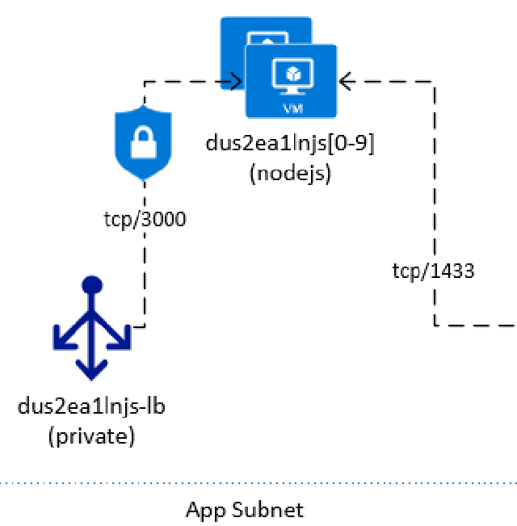

Slide 8
